Slide 1
Kaluza-Klein Electroweak Dark matter
Dong Woo Kang (SKKU)
T. Flacke, DWK, K. C. Kong,
G. M. Mohlabeng, S. C. Park
arXiv:1503.xxxxx

Slide 2
Outline
UED review
Model setup
Phenomenology and precision test
Electroweak precision test
Dilepton resonance at the LHC
Relic abundance of electroweak KK DM
Conclusions

Slide 3
Universal Extra Dimension model
Model with flat, compact extra dimensions in which all fields propagate.[Appelquist, Cheng, Dobrescu,(2001)]
The Standard Model (SM) particles are identified with the zero-modes of the Kaluza-Klein (KK) towers.
We focus on one extra dimension compactified on $S^{1}/Z_{2}$.
KK-parity
$$y=−\frac{πR}{2}$$
$$y=\frac{πR}{2}$$
$$y=\frac{πR}{2}$$
$$y=\frac{πR}{2}$$
$$y=−\frac{πR}{2}$$
$$y=\frac{πR}{2}$$
$$y=0$$

Slide 4
Kaluza-Klein Parity
KK-parity
$$y=−\frac{πR}{2}$$
$$y=\frac{πR}{2}$$
$$y=0$$
KK-parity is $Z_{2}$reflection about the middle point of extra dimension.
The presence of orbifold fixed points breaks 5D translational invariance but a discrete $Z_{2}$parity (KK-parity) remains.
The lightest KK particle (LKP) is stable!
With KK-parity, UED mimics MSSM+R-parity. Some call UED as “Bosonic SUSY”.

Slide 5
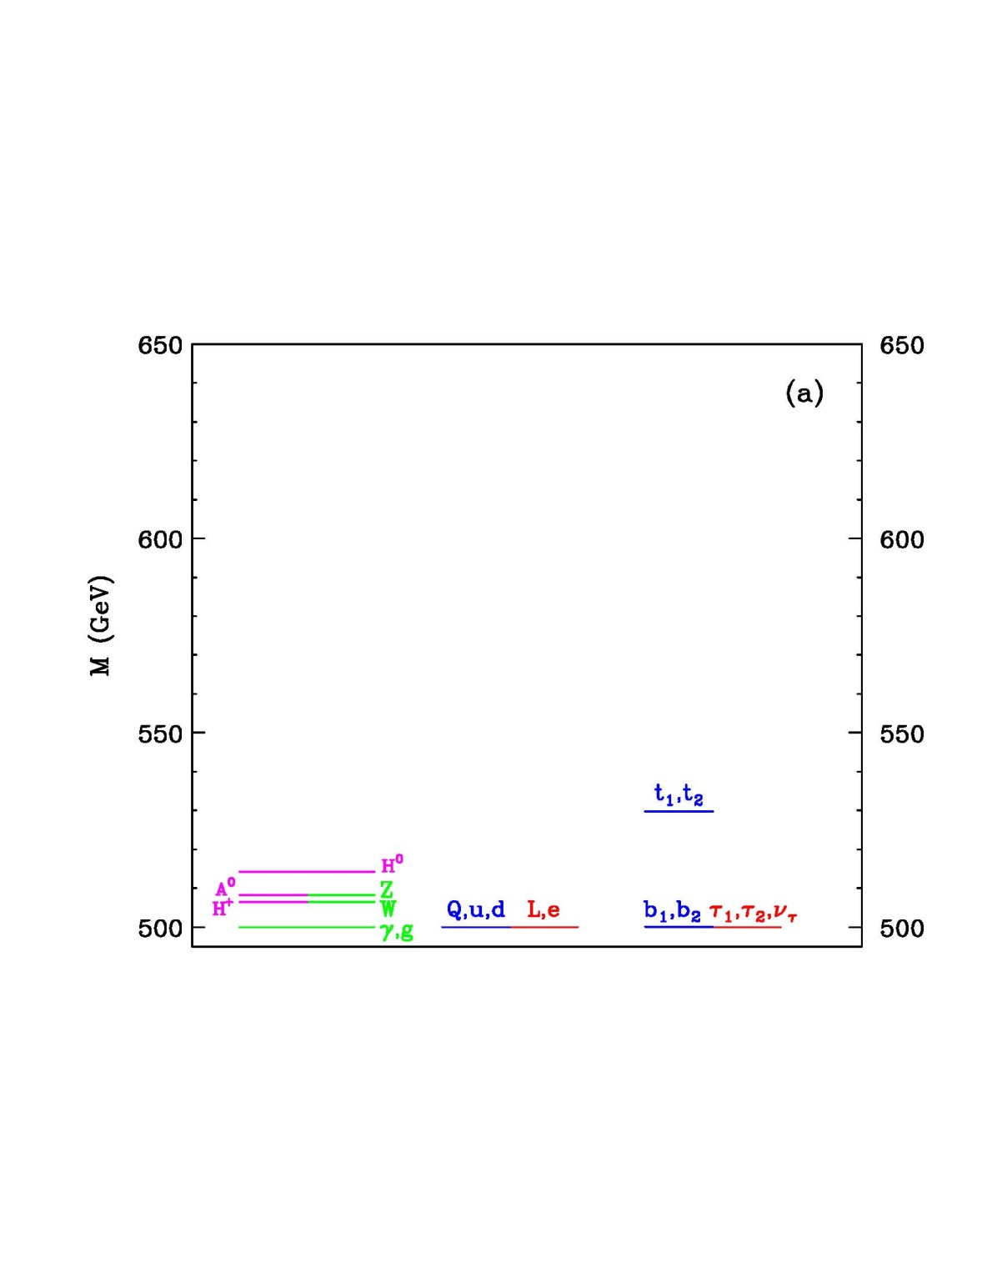
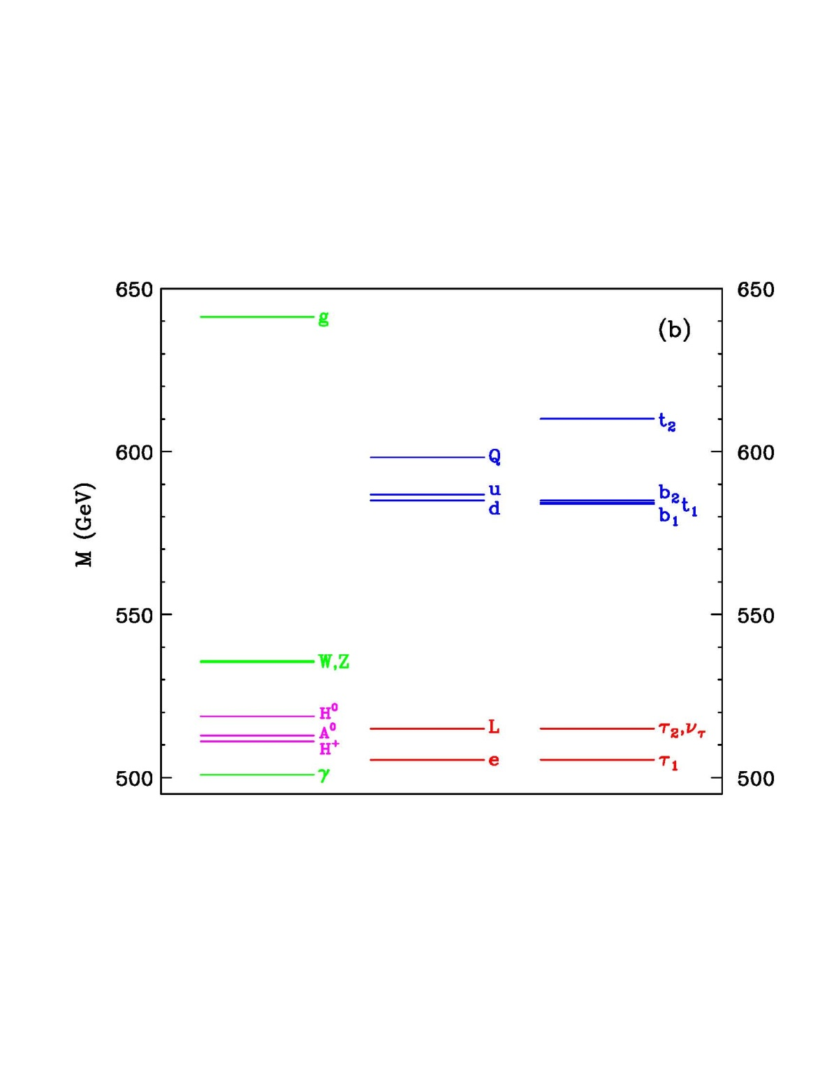
“Minimal” Universal Extra Dimension model
The LKP is KK photon i.e. KK $B^{(1)}$.
[Cheng, Matchev, Schmaltz, (2002)]
Tree level
1-loop level

Slide 6
General UED action
5D Bulk UED action
[Flacke, Kong, Park, (2013)]
Gauge
Fermion
Higgs
Yuakawa
Boundary Localized Kinetic Terms
KK-parity
Notes:
S_{5}=\int d^{4}x\int_{-L}^{L}dy[\mathcal{L}_{V}+\mathcal{L}_{\Psi}+\mathcal{L}_{H}+\mathcal{L}_{Yuk}]
S_{bdy}=\int d^{4}x\int_{-L}^{L}dy(\mathcal{L}_{\partial V}+\mathcal{L}_{\partial \Psi}+\mathcal{L}_{\partial H}+\mathcal{L}_{\partial Yuk})[\delta(y-L)+\delta(y+L)]
\mathcal{L}_{\partial V}=-\frac{r_{G}}{4}G_{\mu\nu}\cdot G^{\mu\nu}-\frac{r_{W}}{4}W_{\mu\nu}\cdot W^{\mu\nu}-\frac{r_{B}}{4}B_{\mu\nu} B^{\mu\nu}
\mathcal{L}_{\partial \Psi}=\sum_{\Psi=Q,L}ir_{\Psi}\bar{\Psi}_{L}D_{\mu}\gamma^{\mu}\Psi_{L}+\sum_{\Psi=U,D,E}ir_{\Psi}\bar{\Psi}_{R}D_{\mu}\gamma^{\mu}\Psi_{R}
\mathcal{L}_{\partial H}=r_{H}(D_{\mu}H)^{\dagger}D^{\mu}H+r_{\mu}\mu_{5}^{2}|H|^{2}-r_{\lambda}|H|^{4}
\mathcal{L}_{\partial Yuk}=r_{\lambda^{E}}\lambda_{5}^{E}\bar{L}HE+r_{\lambda^{D}}\lambda_{5}^{D}\bar{Q}HD+r_{\lambda_{5}^{U}}\bar{Q}\tilde{H}D+h.c.
\mathcal{L}_{V}=\sum_{\mathcal{A}}^{G,W,B}-\frac{1}{4}\mathcal{A}^{MN}\cdot \mathcal{A}_{MN}

Slide 7
Example1. Split UED
5D Bulk UED action
[Park, Shu, (2009)]
[Chen, Nojiri, Park, Shu, Takeuchi (2009)]
[Kong, Park, Rizzo(2010)]
Gauge
Fermion
Higgs
Yuakawa
Fermion Lagrangian
Bulk mass term
Boundary terms
Universal boundary parameter
Notes:
\mathcal{L}_{\Psi}=\sum_{\Psi}^{Q,U,D,L,E}i\bar{\Psi}\overleftrightarrow{D}_{M}\Gamma^{M}\Psi

Slide 8
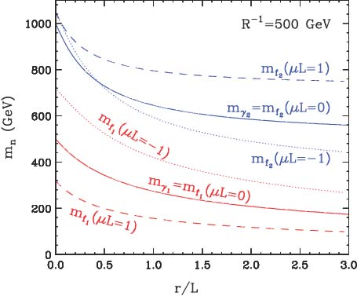
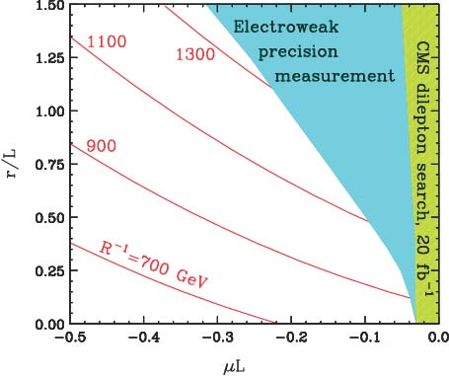
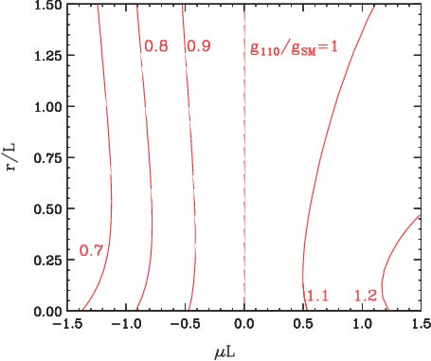
Example1. Split UED
Mass splitting between KK quarks and KK leptons gives good fit for PAMELA cosmic ray measurement.
[Chen, Nojiri, Park, Shu, Takeuchi (2009)]
[Kong, Park, Rizzo(2010)]
[Kong, Park, Rizzo(2010)]

Slide 9
Example2. non-minimal UED
5D Bulk UED action
[Flacke, Menon, Phalen (2008)]
Gauge
Fermion
Higgs
Yuakawa
Boundary terms
KK-parity
Phenomenological studies have been focused on the universal boundary parameter or extreme case, i.e., $W_{3}^{(1)}$is the LKP.
[Flacke, Menon, Sulivan (2012)]

Slide 10
Our model set up
UED bulk action + BLKT of electroweak gauge sector
In our analysis, we neglect the BLKTs of Higgs for simplicity. But if we turn on the Higgs BLKTs, KK Higgs can become LKP in some parameter space.
We set BLKT at the electroweak scale, not at the Cut-off scale.
In MUED, there is no BLKT but one-loop contribution plays a role as boundary localized term.
Gauge
Fermion
Higgs
Yuakawa
Boundary parameters

Slide 11
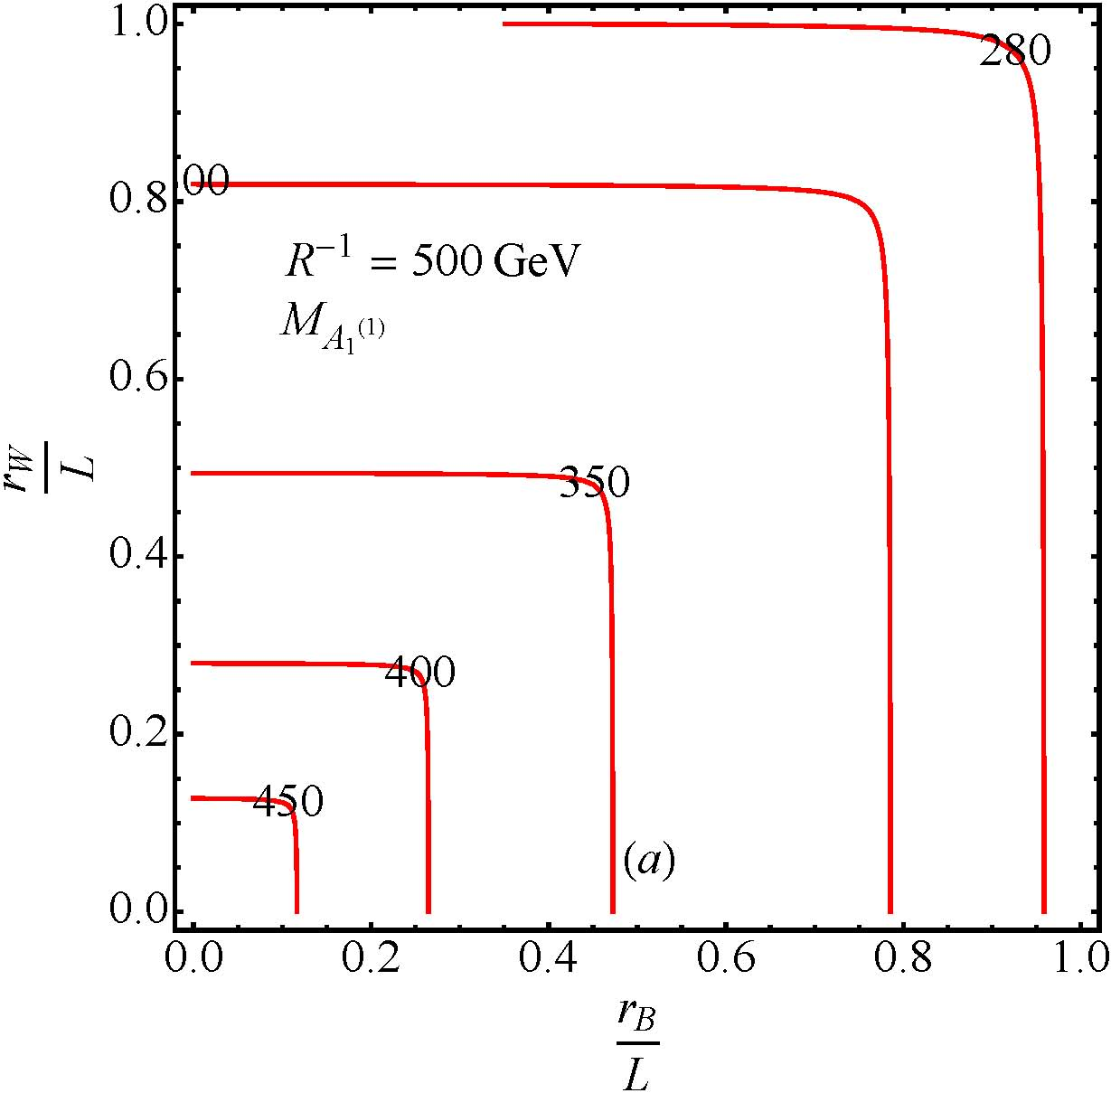
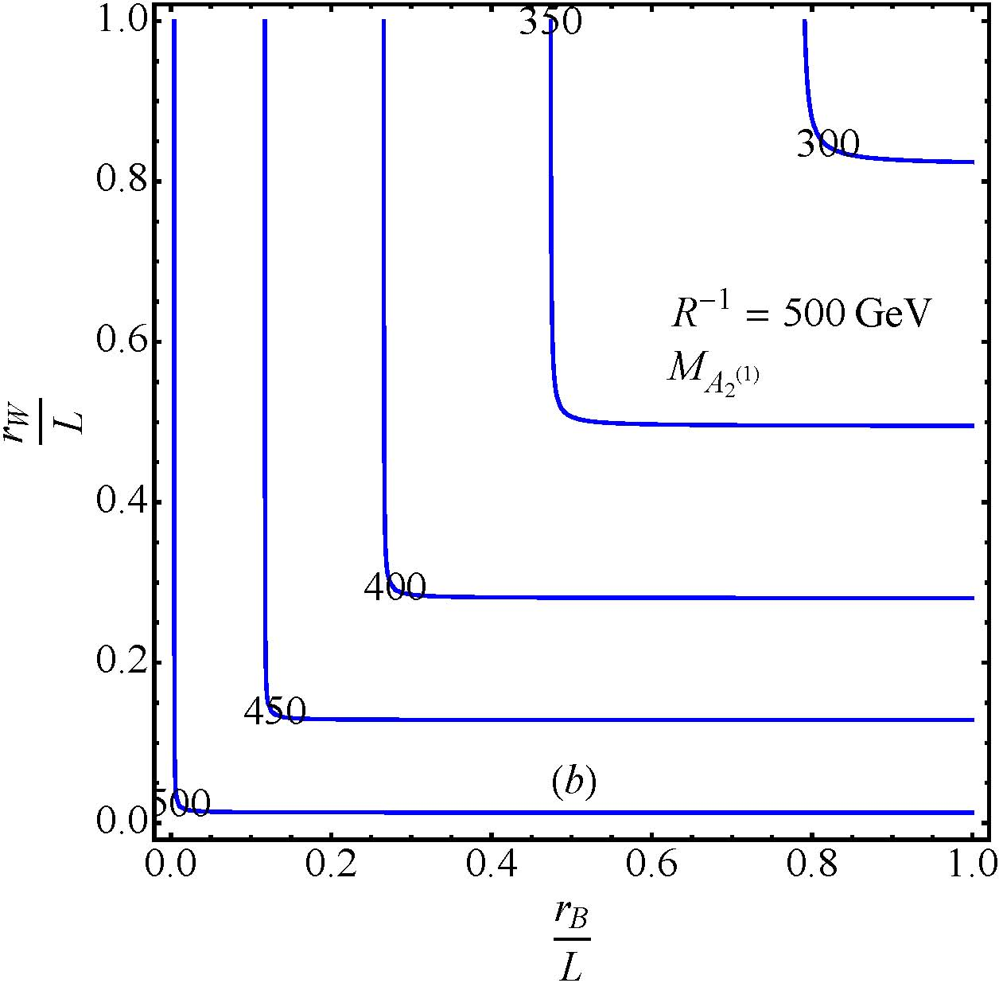
Mass spectrum KK level-1
The lightest mass eigenstate
Heavy mass eigenstate

Slide 12
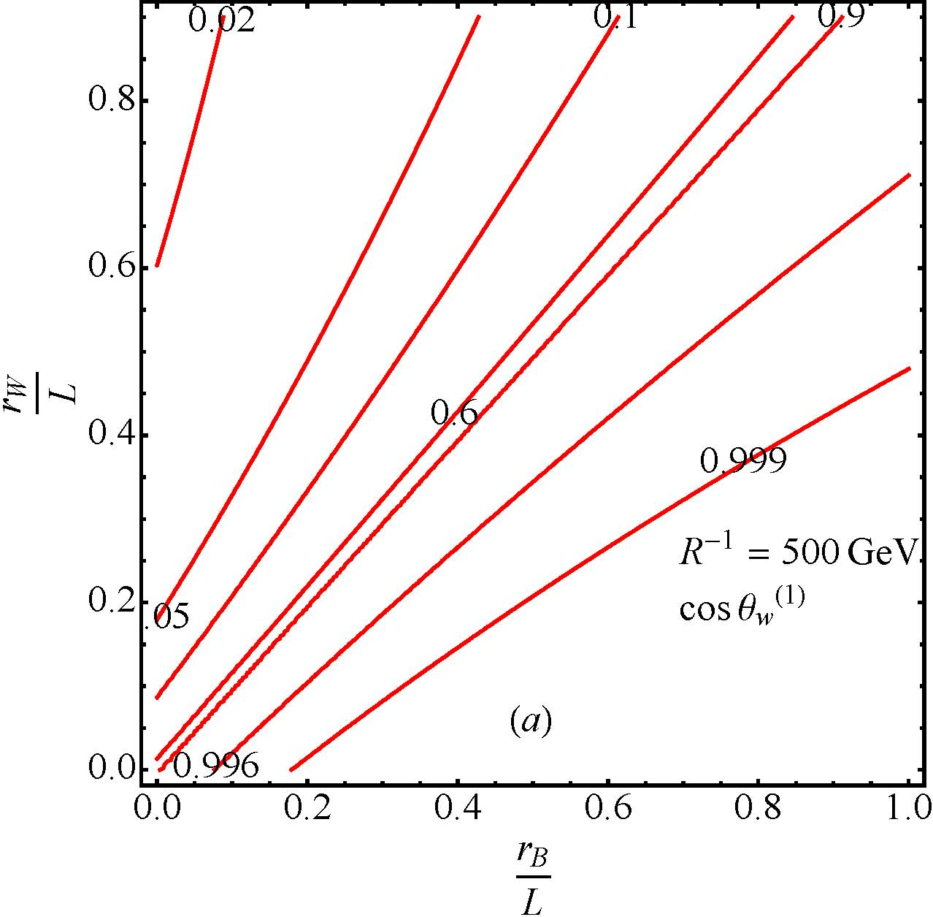
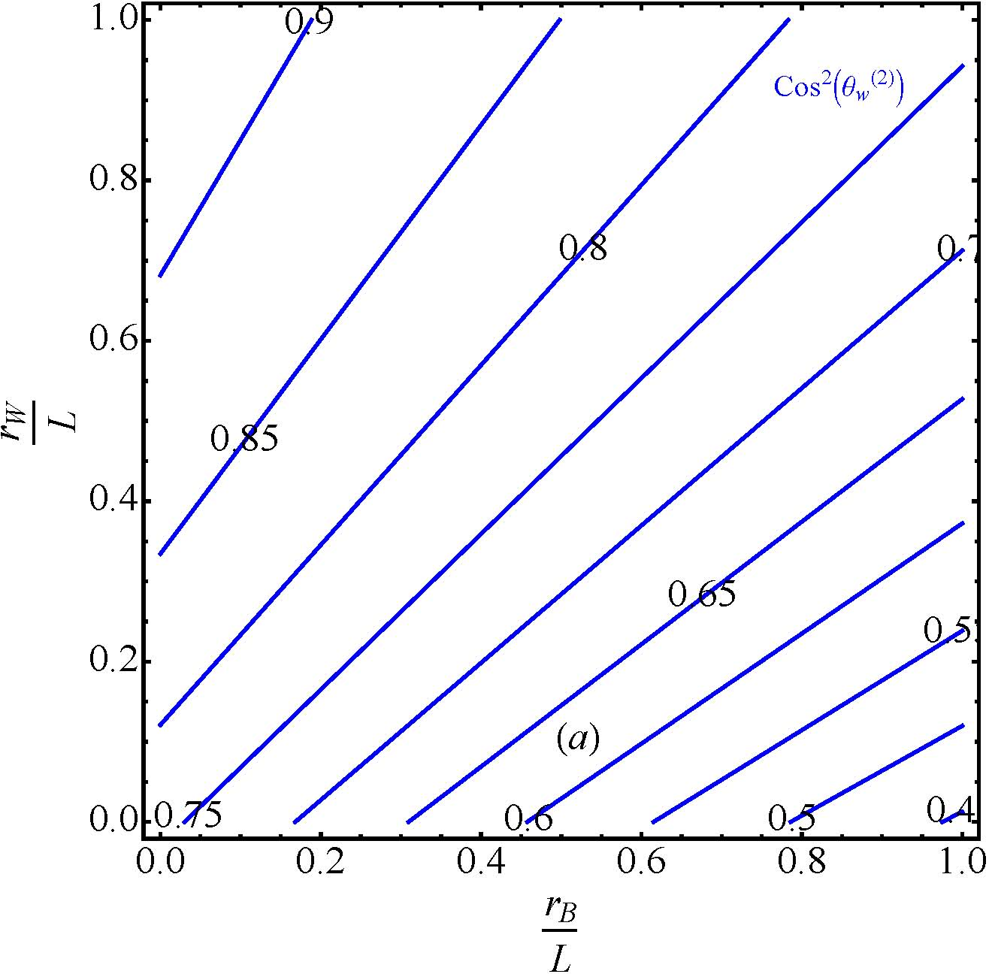
KK mixing angle
1st KK mixing angle
2nd KK mixing angle

Slide 13
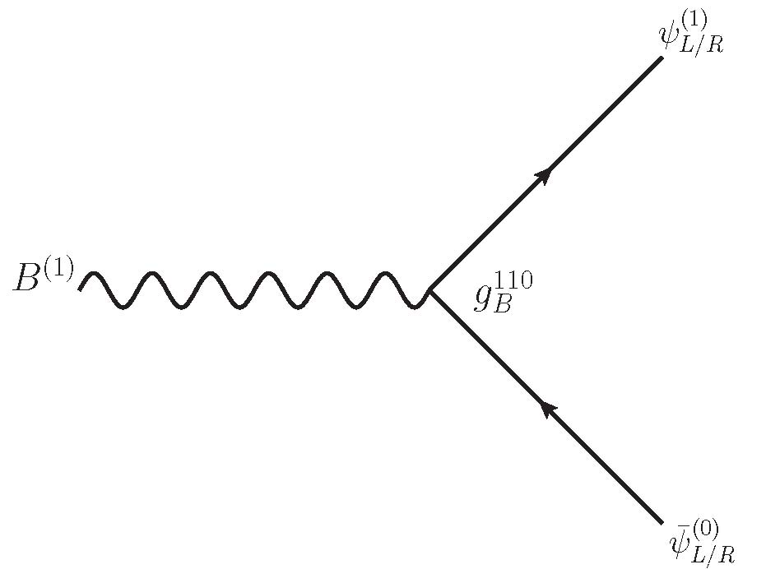
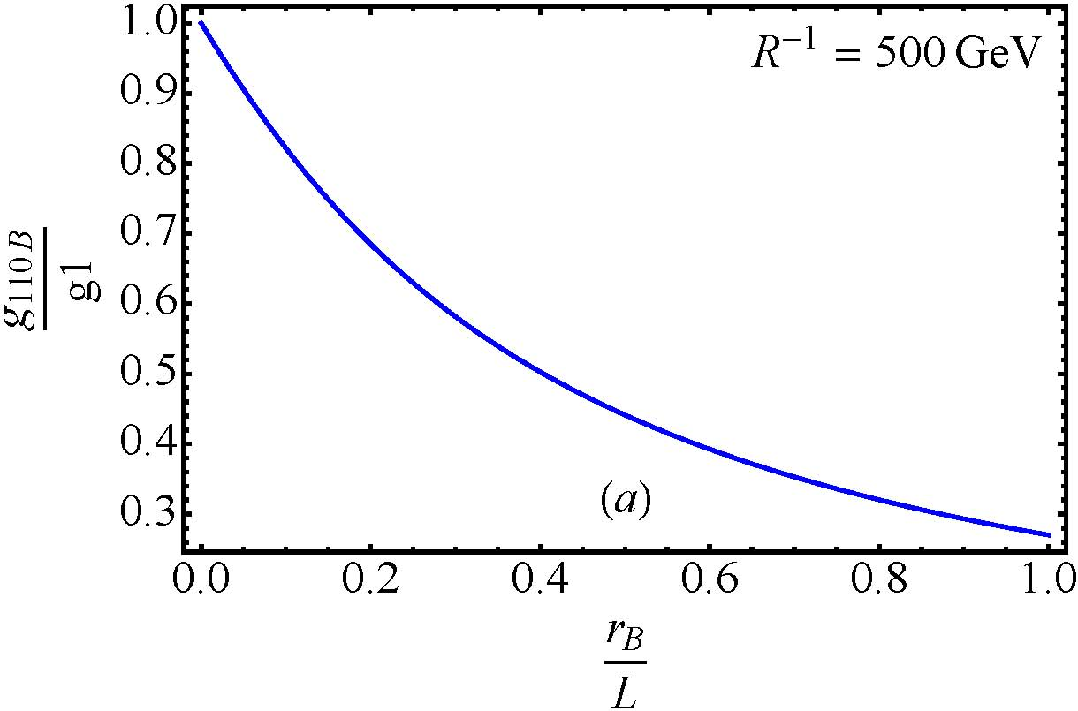
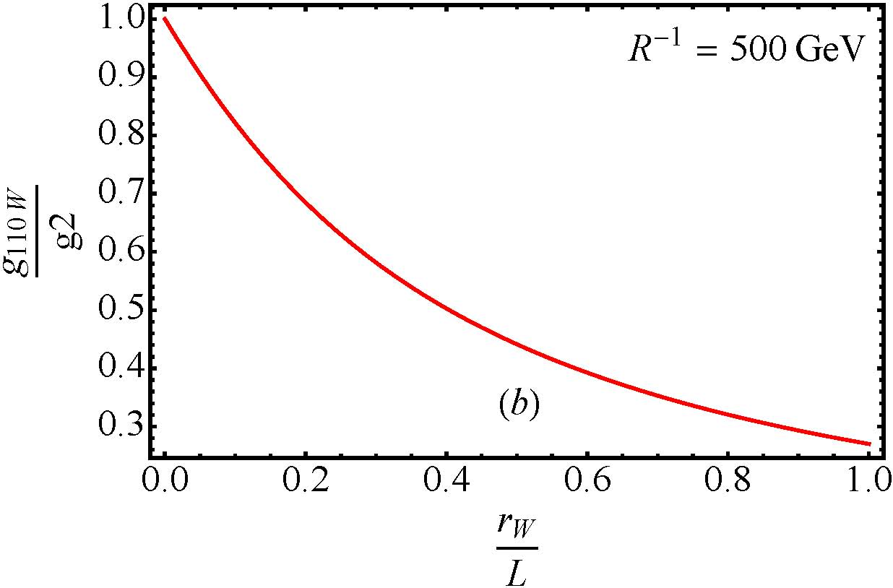
Effective Couplings

Slide 14
Phenomenology and precision test
Electroweak precision test
Even numbered KK gauge boson affect the four Fermi interactions.
Collider searches
2nd KK gauge boson resonance searches.
Relic density
Upper bound from DM relic abundance.

Slide 15
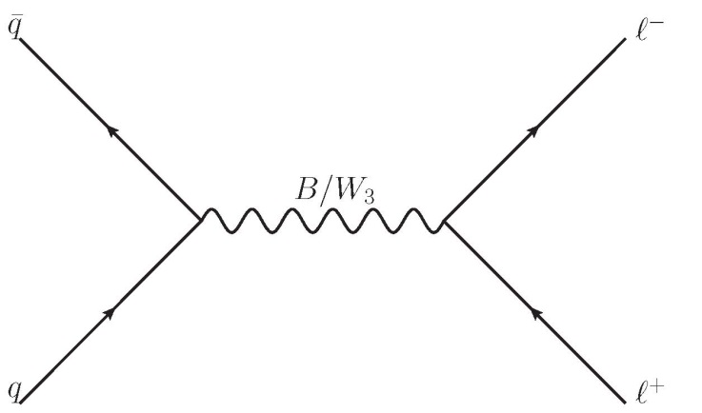
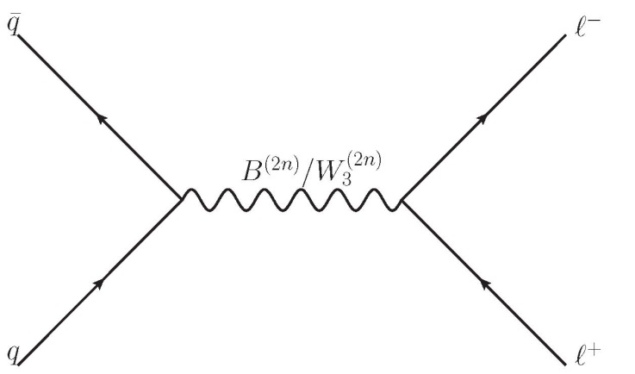
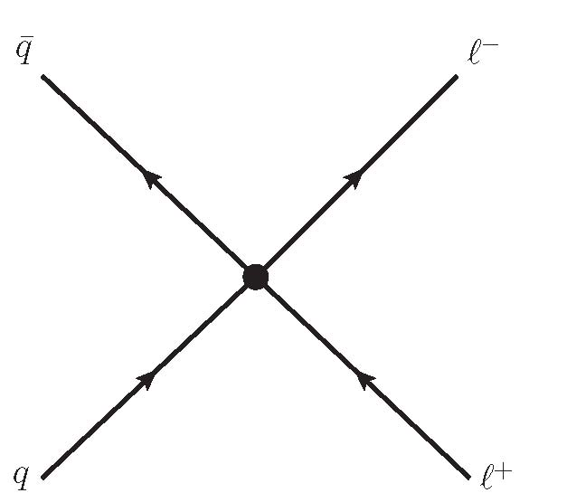
EWPT 4 Fermi operators

Slide 16
EWPT 4 Fermi operators
[Huang, Kong, Park (2012)]
Overlap integral from couplings
[PDG (2014)]

Slide 17
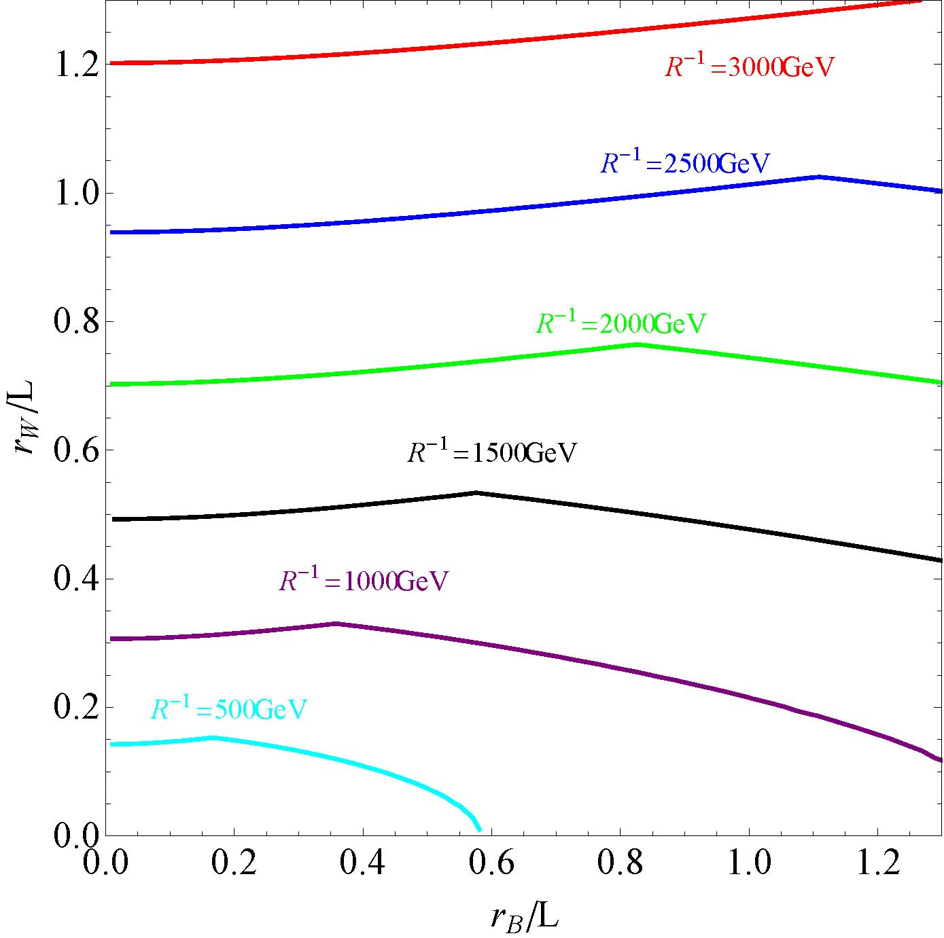
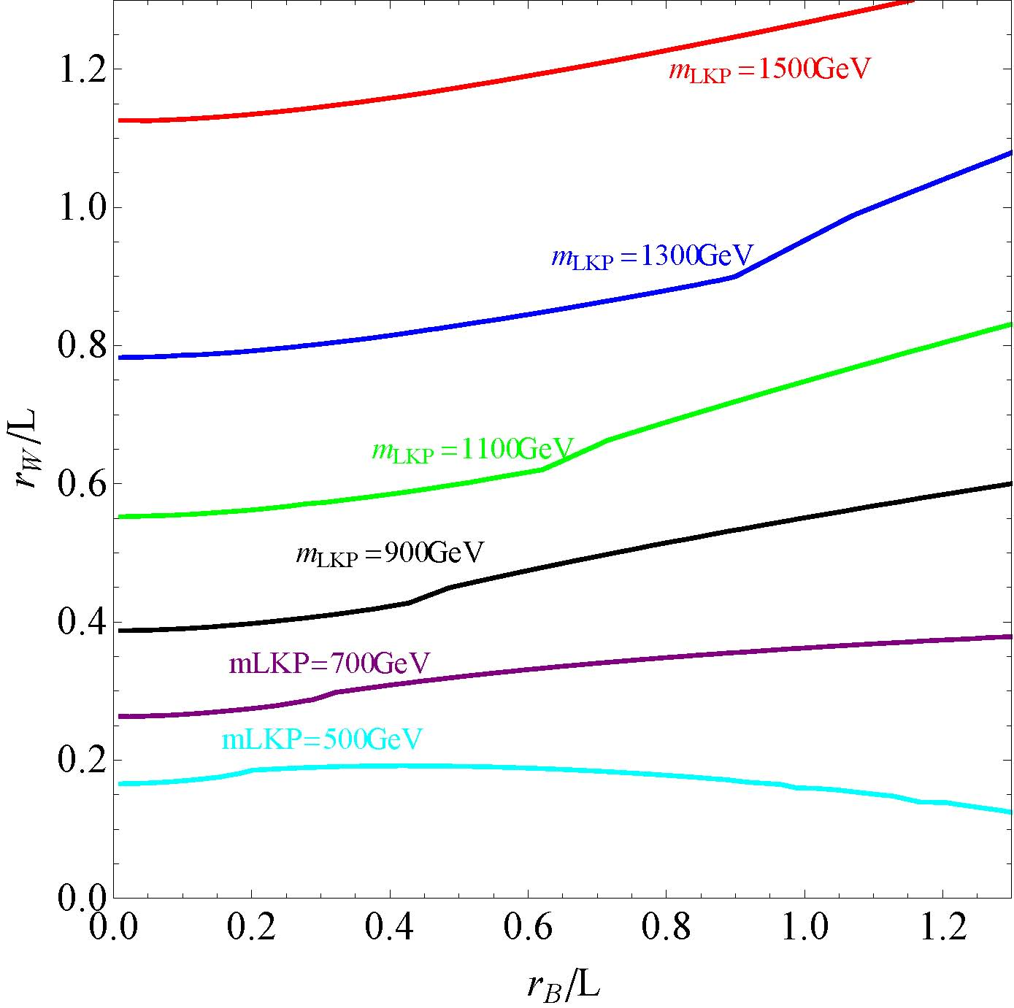
EWPT 4 Fermi operators

Slide 18
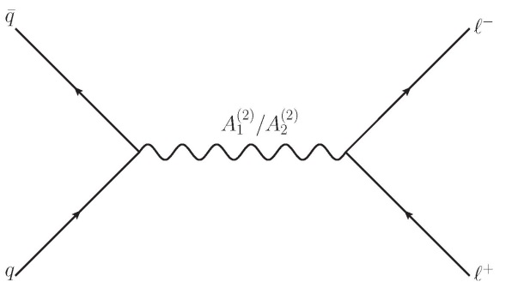
Collider searches

Slide 19
Collider searches
Dilepton resonance search at the LHC7,8
ATLAS [G.Aad et al., arXiv:1405.4123]
Dielectron(20.3fb-1) dimuon(20.5fb-1)
Cuts
Dielectron($P_{T}$>35GeV, eta <2.47 $E_{T1}$>40GeV, $E_{T2}$ >30GeV)
Dimuon($P_{T}$>24GeV or 36GeV, $P_{T}$ >25GeV)
Background
Z/$γ$, diboson, ttbar, dijets and W+jets
For SSM Z’ benchmark : 2.9 TeV
CMS [CMS-PAS-EXO-12-061]
Similar results
We use CalcHep for the modeling and calculation of the cross-section assuming $A_{1}^{(2)}$and $A_{2}^{(2)}$ are the heavy resonances.
PDF: cteq6l

Slide 20
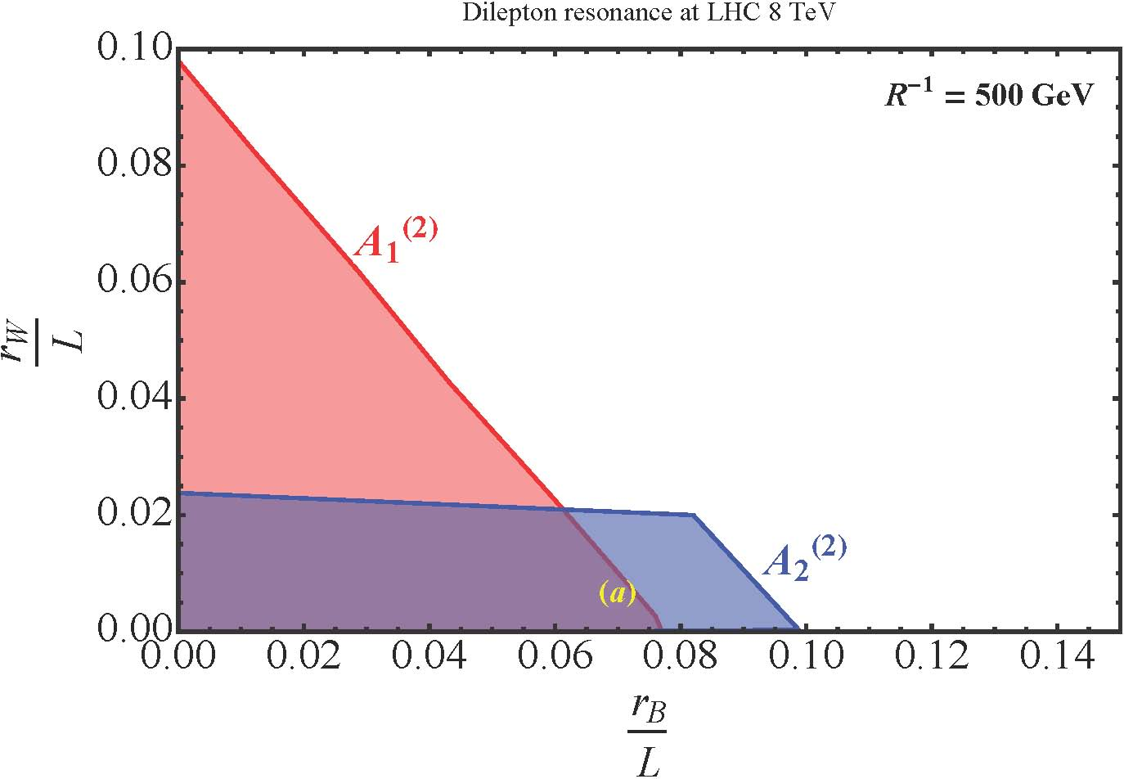
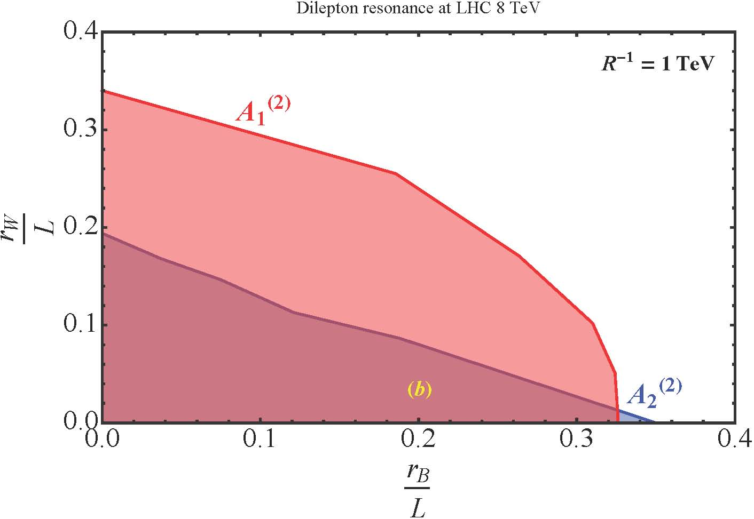
Collider Searches

Slide 21
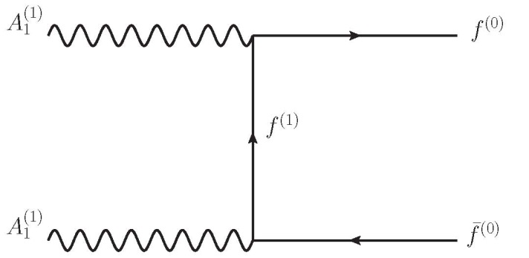
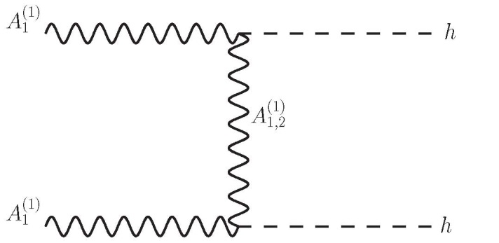
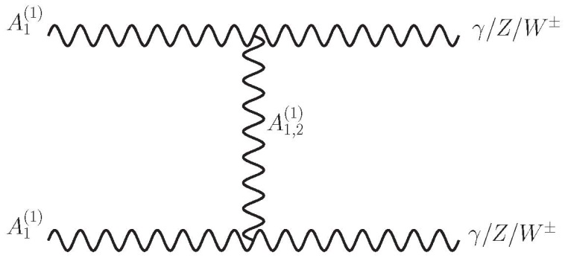
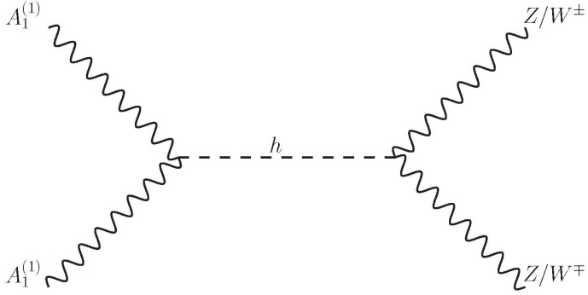
Relic density
We obtain an upper bound on $M_{LKP}$ from observed DM relic abundance by Plank2015.
Annihilation channels

Slide 22
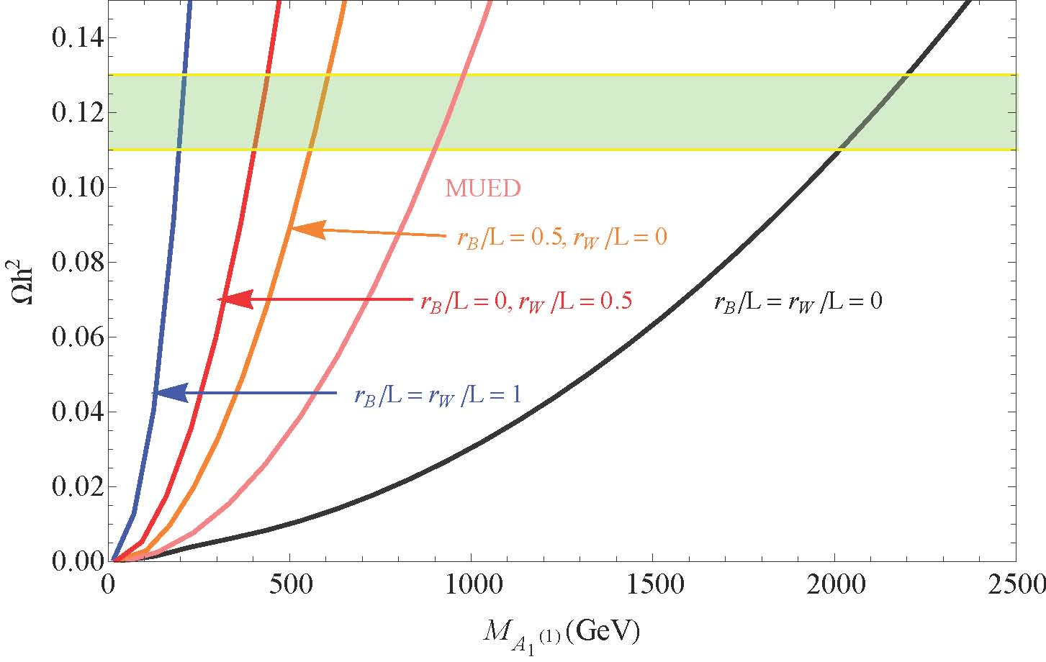
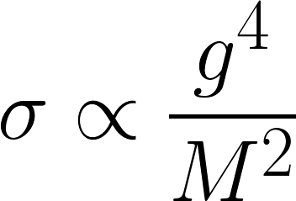
Relic density

Slide 23
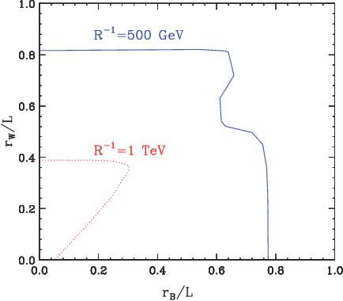
Relic density

Slide 24
Conclusions
Non-zero BLKTs affect the UED KK mass spectrum as well as couplings amongst different KK mode particles.
Considering BLKTs, the LKP is not only commonly considered as $B^{(1)}$ but the mixture of $B^{(1)}$ and$W_{3}^{(1)}$.
Combination of DM, electroweak, and LHC constraints put substantial bounds on boundary parameters for given $R^{−1}$.
LHC14 and future DM searches will give us more answers for extra dimension.

Slide 25
Thank you

